Slide 1
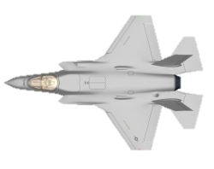
USMC Operational Efforts
DISTRIBUTION STATEMENT A: Approved for public release; distribution is unlimited.

Slide 2
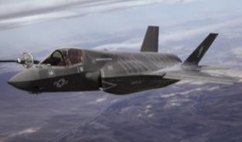
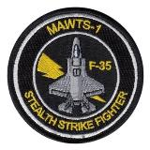
Pilot Training
FRS Training
MAWTS-1
Produces F-35B qualified wingmen
Trained 60 F-35B conversion pilots since 2011
EA-6B students used to validate CAT 1 curriculum in Fall 2015
CAT 1 training (straight from training command) started in February 2016
Scheduled to train 63 additional F-35B pilots by end of 2018
Feeds VMFA-121, VMFA-211, VMX-1, MAWTS, and VMFAT-501
Advanced training course for USMC Aviators; creates fleet Weapons and Tactics Instructors
F-35 fully integrated into the WTI construct.
Major evolutions validated 4th/5th Generation fighter integration and gained valuable lessons learned in preparation for future F-35 courses.
First two instructors validated the WTI curriculum in Fall 2015
Initial F-35 WTI students:
First 3 F35B WTI’s graduated May 2016
1 additional WTI graduated Oct 2016 class

Slide 3
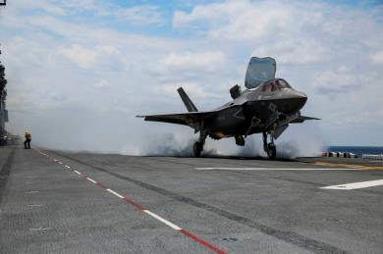
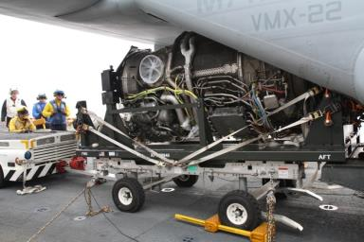
F-35B OT-1 Aboard USS Wasp
18-30 May. Led by VMX-22.
Supported by VMFA-121 and VMFAT-501
4 x VMFA-121 aircraft, 2 x VMFAT-501 aircraft
Approximately 240 Pers: Military, Gov Civ, CLS
Event started on schedule: 18 May 2015
Power Module delivered to the ship: 21 May 2015
3 DV and Media Visits executed: 20, 22, 26 May 2015
Executed 110 sorties / 76.1 flight hours
CQ and standard day and night extended range operations
Assessed LSO Software
Heavy focus on Logistics and Sustainment
Suitability of shipboard maintenance // shipboard logistics // suitability of support equipment // ALIS seabased suitability // verification of ship modifications // development of the Afloat Spares Pack

Slide 4
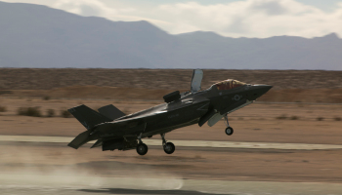
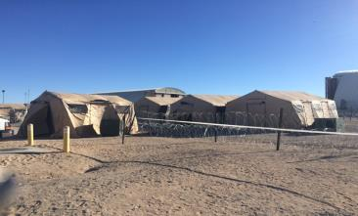
Exercise Steel Knight
Deployed 8 F-35B to 29 Palms Marine Corps Air Ground Combat Center
14 Pilots and 162 maintenance and support personnel, along with the required spares, tools, and support equipment (SE), were deployed from 2 to 16 December 2015 to support flight operations (9 to 15 December 2015).
Executed CAS with live ordnance
All ordnance on target within 15 seconds of TOT
Issues with range regulations limited available targets; highlights challenges with integrating a new weapon system into the inventory.
Executed operations at Red Beach EAF to examine Mobile Forward Arming and Refueling issues.
“The STOVL functionality of the F-35B allowed the pilots to operate at the EAF using only the first 1,500 ft. of the 8,000 ft. runway for takeoffs and landings… This capability should enable the USMC to operate the F-35B from short or damaged runways.” – JOTT Letter of Observations 17 February 2016
Notes:
Key Takeaways
Deployed squadron using USMC organic assets
Established expeditionary SAPF
Operated ALIS in austere environment for 3 weeks
Conduct STOVL operations on AM2 for sustained period of time
No major mx or FOD issues due to diligence of squadron Marines

Slide 5
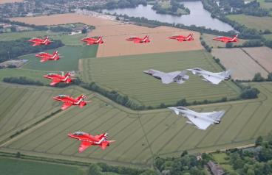
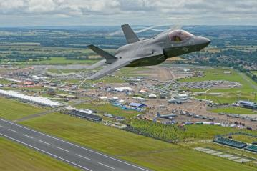
RIAT-FIAS Airshows
23 Jun-29 Jul
Led by VMX-1, supported by VMFAT-501
3 x VMFAT-501 aircraft (One was UK BK-3)
102 Pers: US and UK Military, Gov Civ, CLS
Translant 29 Jun 16, RTB 22 Jul 16
23 Sorties, 73.5 hours
AM 2 vertical landing (VL) pad constructed by USMC and Royal Engineers
First F-35 deployment to UK
2 Ship Fly past Queen Elizabeth Carrier and RAF Marham
First VL OCONUS 6 Jul 16
3 of 3 Fly days at RIAT
Flypast with Red Arrows and Typhoon into Demo
Flypast with KC-130J
5 of 5 Fly days at FIAS
Open show with Red Arrows, flypast with KC-130J
Demo
Notes:
I know its an airshow…..but key takeaway is:
-- First Translant
-- All three aircraft up the entire time; no vuls dropped
-- RTB on time
-- Also, operated on foreign soil without and ALIS SOU by using NIPR lines to reach back to home server

Slide 6
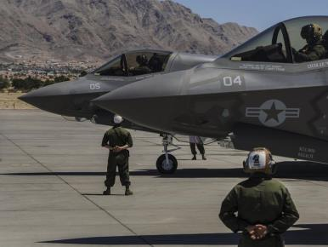
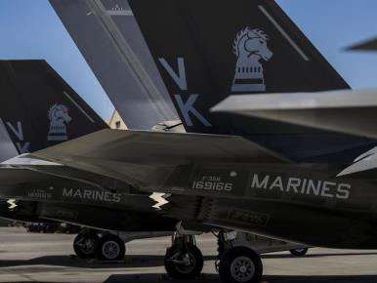
VMFA-121 at Red Flag 16-3
Ops / Maintenance
Milestones / Highlights
June 29, 2016 – July 29, 2016
8 Aircraft / 157 personnel
85 Sorties, 120 hours
Detachment for training
Mission Commander of the Exercise Award
High end, opposed, full spectrum operations
Simulate movement to Japan / deploy ALIS
Notes:
Key Takeaways:
Statements from Red Flag Staff: “We saw the F-35 do things we’ve never seen done before at Red Flag”
Pilots stated they were performing all assigned METL within each mission. Truly multirole.

Slide 7
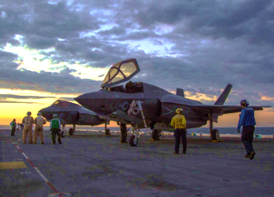
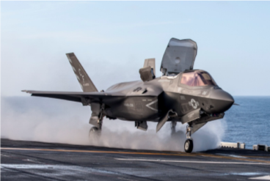
DT-3
Currently at sea
DT-3 / OT assist
Envelope expansion heavy sea state
Asymmetric loading
Live weapons
JPALS
LINK integration
Lightning Carrier Proof of Concept
3 days
12 F-35, 2 MV-22, 1 UH-1Y, 1 AH-1Z

Slide 8
DT-3 Accomplishments
“Firsts”
First DT—OT integrated test event
First integration of ALIS SOUv2 aboard ship
First engine and lift fan R&I aboard L-Class ship
First live ordnance operations aboard ship
First F-35B integration with AEGIS
First integration of MV-22 / UH-1Y / AH-1Z / F-35B aboard ship
12 F-35Bs aboard ship (previous maximum was 6)
OT flying Block 3F at-sea
First Royal Navy pilot F-35B carrier qualified
Developmental Test Points
Night Vision Camera (NVC) Operations
Dynamic Interface testing
Expanded Sea States
Joint Precision Approach Landing System (JPALS)
Center of Gravity (CG) / Gross Weight (GW) envelope expansion
Asymmetric / external stores envelope expansion
Envelope Expansion at spots 2.5,4,5,6

