Slide 1
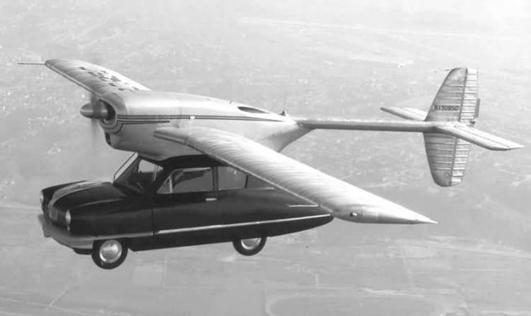
UNCLASSIFIED
Bloomberg BusinessWeek Epoch Times and the Author
Of Flying Cars and Propeller Heads
June 2016
Mr. Frank Prautzsch
UNCLASSIFIED

Slide 2
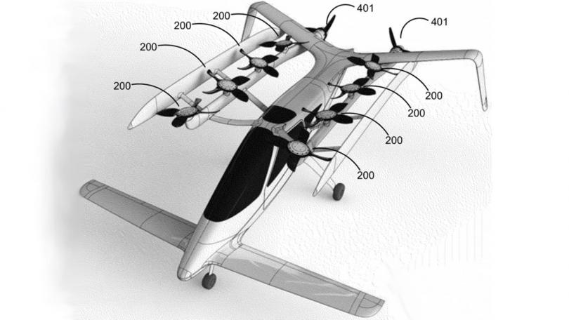
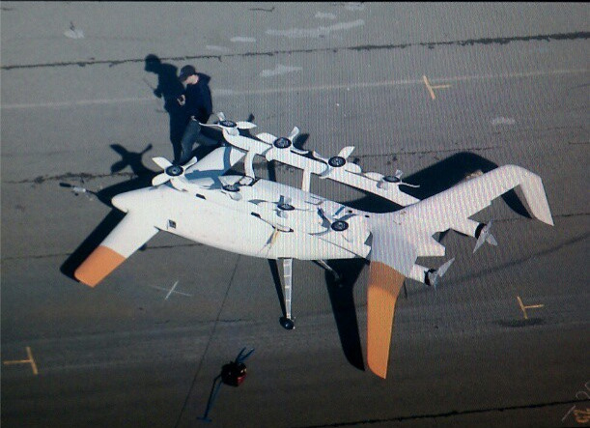
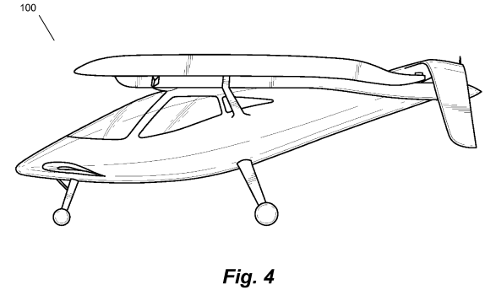
Propeller Heads
Zee.Aero and Kitty Hawk IOC TBD
-Mountain View and Holister CA
-Professor Ilan Kroo -Stanford
-$100M Larry Page Investment
-Electric Propulsion w/Tesla, NASA and Stanford
-Hybrid propulsion and redesign in progress
-2 secret flying prototypes built
-150 employees
-
Zee.One Patent filing (2010)

Slide 3
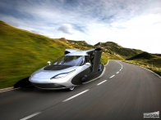
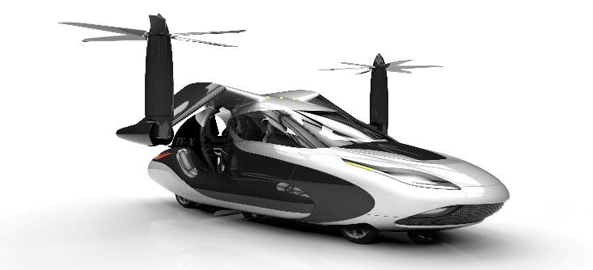
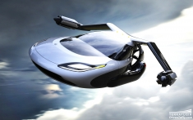
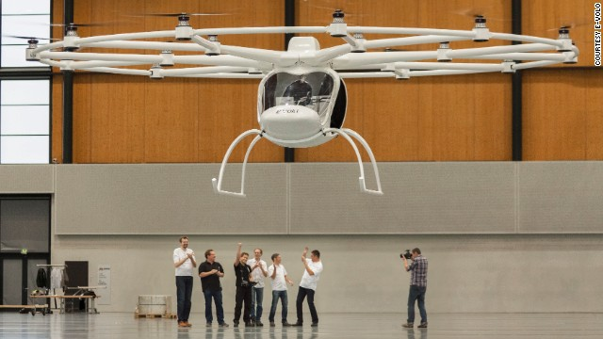
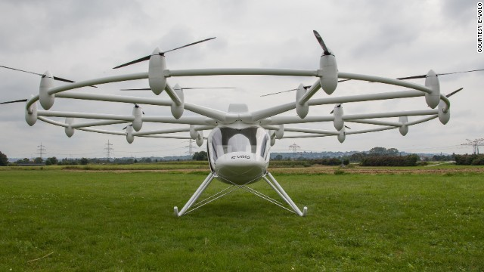
Propeller Heads
Terrafugia IOC 2026
-Woburn MA
-4 passenger + cargo, ballistic parachute
-$120K
-In early development
-Working 1st gen prototype has flown
-500 mi range/ cruise speed of 200 mph
Volocopter IOC 2016
-Karlsruhe GE
-2 passenger
-$280K
-Electric version mature, Hybrid in build
-70 km/hr. for 20 minutes on 110kg battery
-18 rotors, 1000 lbs, 2 hour charge

Slide 4
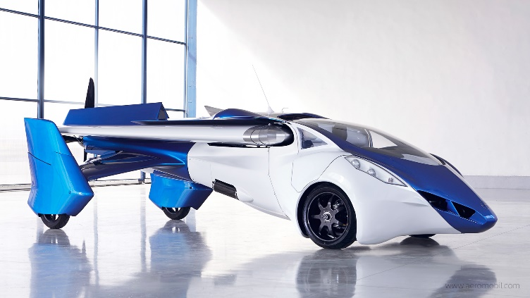
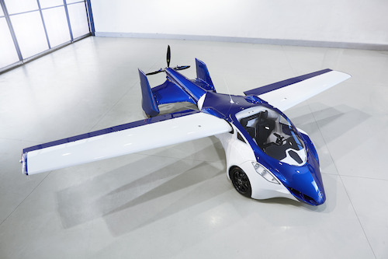
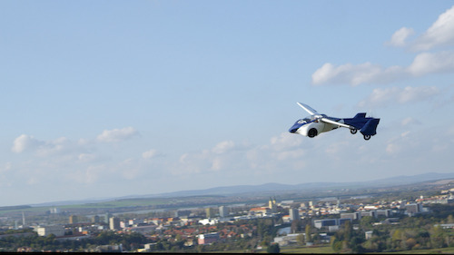
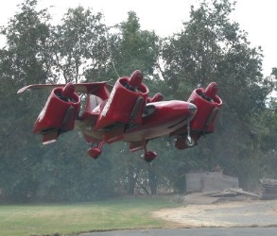
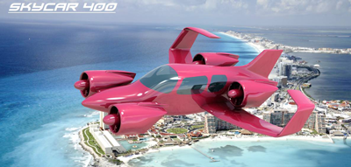
Propeller Heads
AeroMobil 3.0 IOC 2018-19
-Bratislavia, Slovakia
-4 passenger + cargo
-$400K
-Mature design, ROTAX 912 gas engine
-Working 1st gen prototype has flown
-500 mi range/ cruise speed of 124 mph
-Ground/car speed of 100 mph
-200 meter STOL
Moller M400 Skycar IOC 2019
-Davis, CA
-2/4/6 passenger + cargo+ ballistic parachute
-$500K-$1M
-5th Generation VTOL design
-Working 1st gen prototype has flown
-805 mi range/ cruise speed of 131 mph
-Max Speed 308 mph

Slide 5
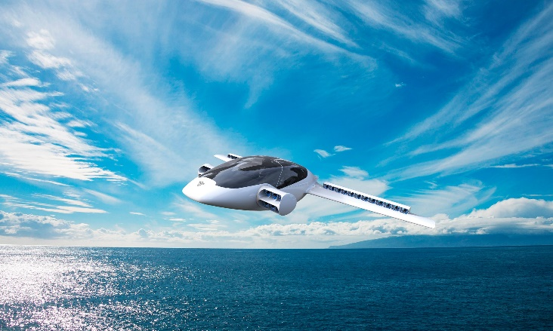
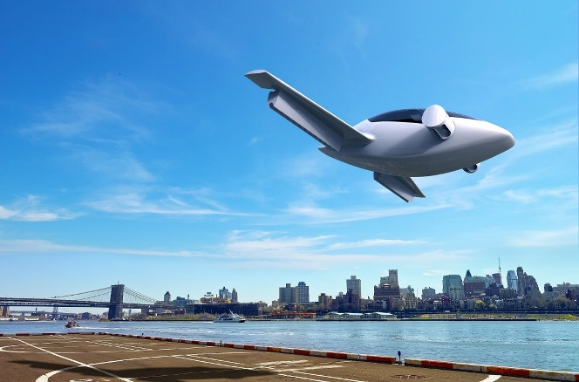
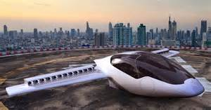
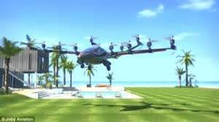
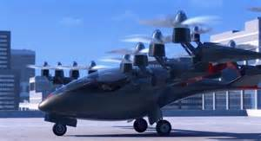
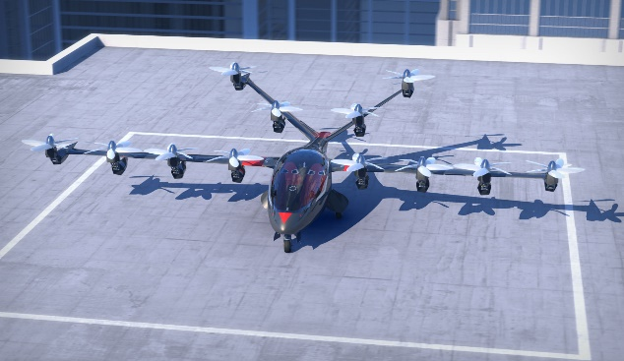
Propeller Heads
Lilium Jet IOC Jan 2018
-Gilching, GE
-2 passenger + cargo
-$TBDK
-24 wing, and 8 fuselage ducted fans/ all electric
-Working 1st gen prototype has flown
-500 km range/ cruise speed of 180 mph
-top speed of 250 mph w/ 435 HP
-EU flight rules established for European transit
Joby S2 IOC 2016
-Santa Cruz, CA
-LeapTech Project with NASA and ESAaero (Sceptor X-Plane)
-Managed Uber-like air-taxi service
-12 rotor VTOL
-Working 1st gen prototype has flown
-200 mi range/ cruise speed of 131 mph
-Max Speed 200 mph

Slide 6
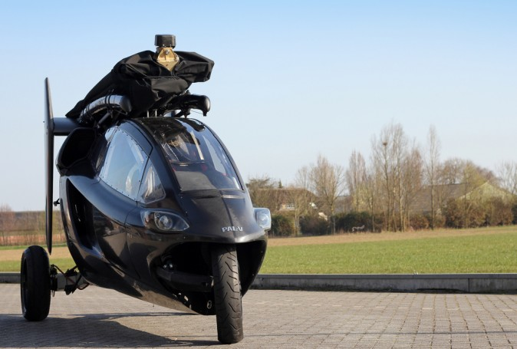
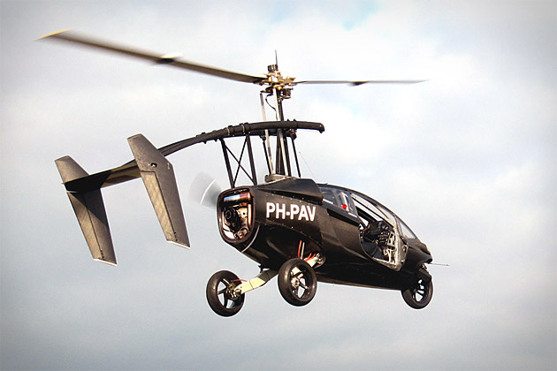
Propeller Heads
PAL-V ONE IOC 2016
-Raamsdonksveer,Holland
-TriCycle Frame/$395K
2 passengers/150 units in production
112 mph @400 km range.
540 ft take off, <100 ft. landing (including complete vertical)- Safes
-Gyro Rotor/Main Rotor is UNPOWERED.
-Rotation is produced by forward propulsion against angular velocity on trim
-Working 2nd gen prototype has flown
-5.5 km glide ratio
-Unpowered landing (including vertical)
-No hover, but no stall speed
-140 kmh for ground vehicle mode
-Hydraulic Articulating suspension for curves
-Vehicle mode: 1200 km/tank of gas . Air=9.5 gal/hr.
-Currently designed with 4000 ft. ceiling
-Very low affect from cross winds or severe weather

Slide 7
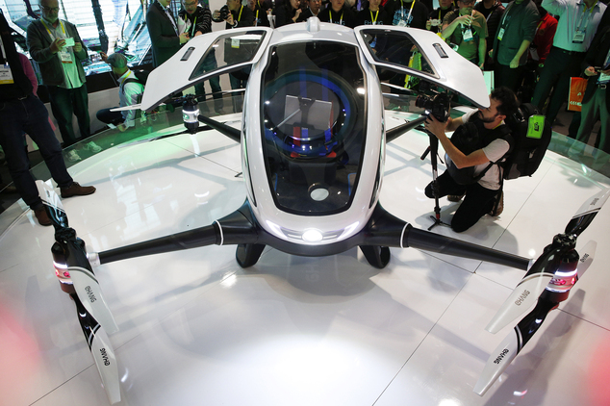
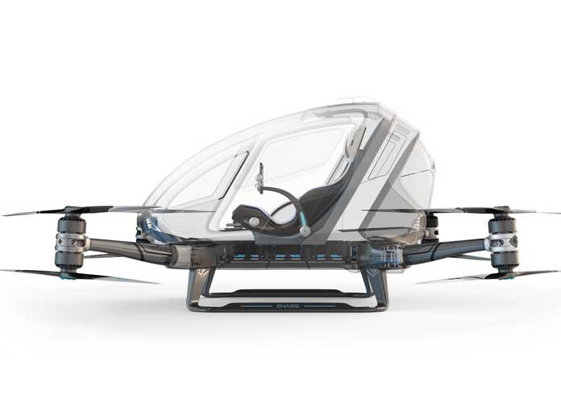
Propeller Heads
EHANG 184
Guangzhou, China
440 LB Payload for 23 min.
2 hr. charge
100-1600 ft operation
Max ceiling of 11,500 ft.
63 mph
$200-300K
Completely automatic pilot..no user involvement except flight plan
Blades fold for parking
Licensed for flight testing in Nevada-
Autonomous flight testing in progress

Slide 8
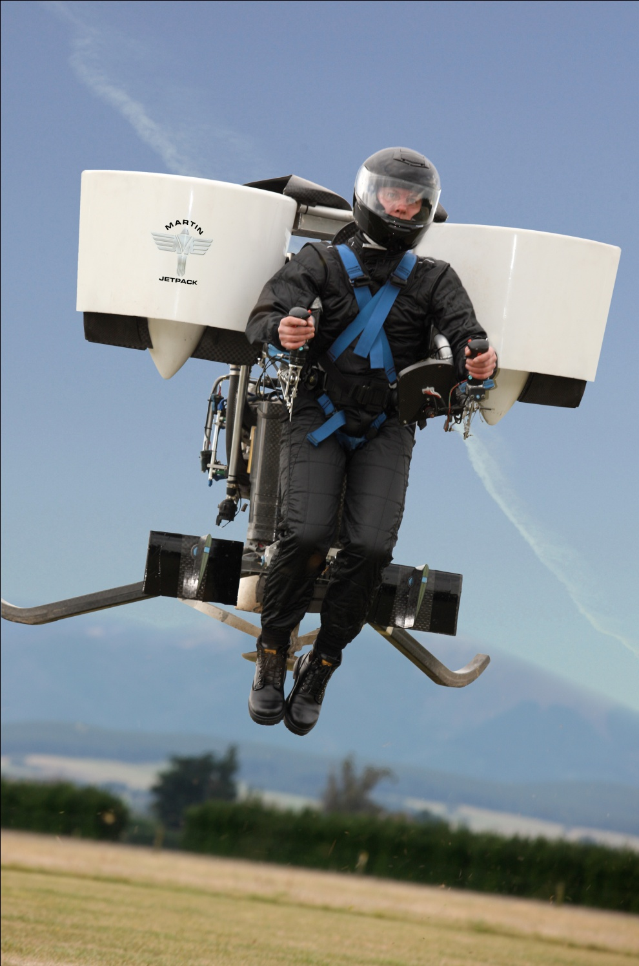
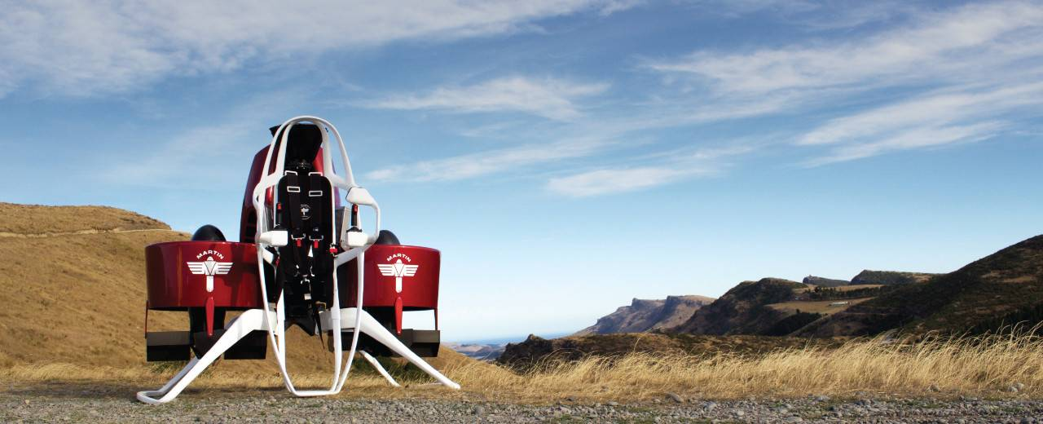
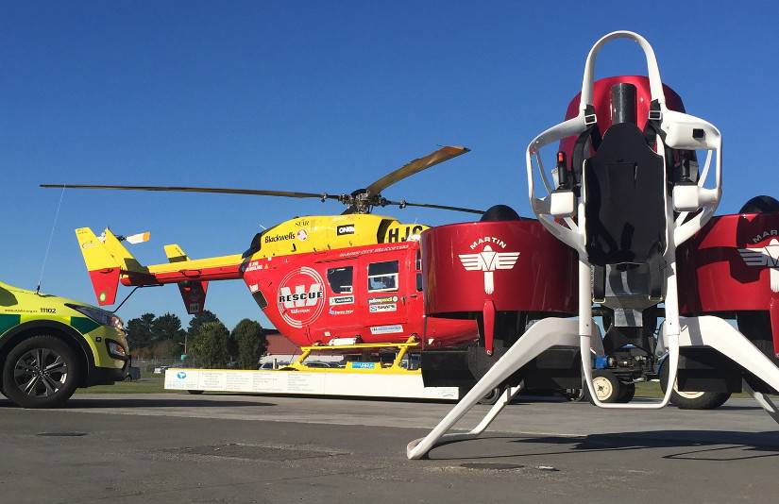
Propeller Heads
Martin Aviation JetPack (Manned/Unmanned)
Christ Church, New Zealand
Height 5 ft/Width 5.5 ft/Length 5 ft
600 ft/80 knots/5 gal fuel/30 min.
Structure=Carbon fiber composite
Empty weight= 250 lbs (excluding safety equipment)
Gross weight =535 lbs
Useful (Pilot) Load =280 lbs+
Maximum thrust =600 lbs+

Slide 9
Flying Car Prototypes

